Slide 1
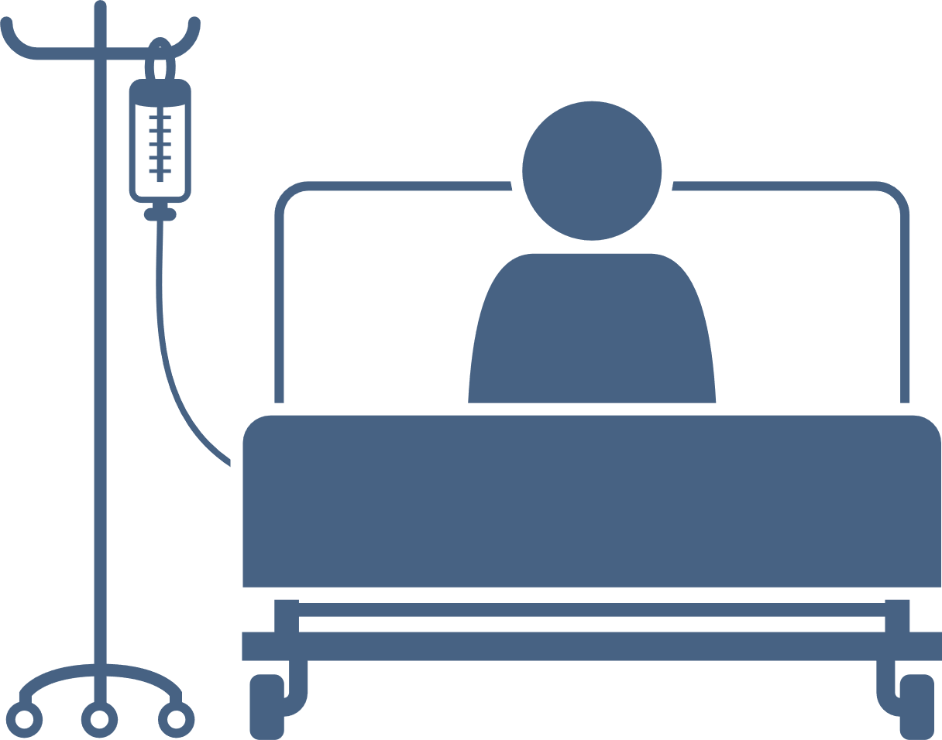
Introduction
Conclusions
Dr Rachael Brooks and Dr Eleanor Warwick, PQIP Fellows, UCLH anaesthetic registrars.
Perioperative Thoracics Team at UCLH: Dr Emilie Hoogenboom, Consultant Anaesthetist UCLH Thoracic CNS Emilia Kaleeva and Shereca Bellinfantie. With thanks to RCoA Patients Voices Focus Group
Patient Empowerment and Education at UCLH
The Patient as an Advocate for DrEaMing
Drinking, Eating and Mobilising (DrEaMing) is associated with reduced length of stay and aims to revitalize the quality improvement (QI) efforts aiding patients’ recovery after surgery¹. A positive collaborative culture with cohesive working between the whole surgical multidisciplinary team is essential for DrEaMing to become a sustained standard of care². Beyond the perioperative team, the other important party that can facilitate DrEaMing are the patients themselves!
Qualitative interview data from a RCoA patient voices DrEaMing focus group and the thoracic perioperative team at UCLH were gathered during development of a PQIP QI collaborative supporting DrEaMing implementation. Key themes are discussed.
Demystifying a patients’ postoperative journey through education, helps make the future familiar and optimises their ability to be an active participant, driving their own recovery and resulting in truly patient-centered care. Patients will have a clearer understanding of why interventions are happening at each stage, and with understanding comes empowerment. Empowerment to ask “when am I getting out of bed?” or “why am I not DrEaMing?”
Lead by resourceful clinical nurse specialists, a streamlined perioperative pathway has been created, that is educating and empowering for patients. A multimedia approach with a consistent message is utilised to educate patients early about what to expect in the peri-operative period and reinforce why enhanced recovery pathways are important in aiding their recovery. Patient understanding and retention of information is enhanced when provided by interactive communication with their clinical team and then reinforced by printed information^{3.}
RCoA Patient Voices Focus Group Perspective
"I want to get home quickly but I don't want to feel rushed, a key contact who I can call if I need, would reassure me"
"I want to avoid complications and long hospital stay, if DrEaMing can help me do this then I will be asking where my breakfast is and when I will be moving"
“Comprehensively promoting the patient as an active participant in their recovery process and rehabilitation”
Two-part pre-assessment to allow for early patient engagement with education materials
Telephone pre-assessment focusing on education around post-operative period and recovery goals
DrEaMing is an empowering and humanising quality metric. Being able to drink, eat and mobilise are basic and fundamental human activities that help patient’s feel more normal and “on the road to recovery”.
Counselling patients that DrEaMing is expected on day one post-surgery gives patients a realistic and empowering goal to aim for and reassures them that their care is not being “fast tracked” due to hospital pressures.
Patients want to do anything to avoid complications and prolonged hospital admissions but need to know the care they are receiving is evidence-based and patient-centered.
Educating patients early on in their perioperative journey about the daily steps post-surgery, including DrEaMing, gives patients the ability to be actively involved in their own post-operative recovery.
Every patient interaction should be used as a chance to reinforce these messages. This not only supports the patients to retain the pertinent information but also reassures them that the whole team are working cohesively around the same goals
"DrEaMing is humanising. It will help make me feel like I am on the road to recovery"
Patient info pack posted / emailed prior to F2F includes recovery diary
Well informed, prepared patients with knowledge of their planned care, feel safer and are more prepared, both physically and mentally, to participate actively in their self-care and recovery³. This self-efficacy around their own recovery means that patient’s themselves can become powerful drivers for QI. Beyond DrEaMing, this empowerment can be harnessed to support any perioperative QI metric, as informed patients are more likely to be proactively involved in
managing their recovery.
Face-to-face pre-assessment within 96 hours prior to surgery to reiterate pre-op education
Empower patients and give them tools to be actively involved in their own recovery
UCLH Thoracics Team Top Tips:
•Involve your MDT from day one
•Accept that trial and error is part of the process
•Identify and nurture your change champions
•You and your team create your culture
•Reflect with your team on what worked and what
has not worked
•Share and disseminate you results
”Engage, Educate and Empower Patients”
Oliver,. C, et al. Br J Anaesth 2022; 129(1), 114–126
PQIP-Annual-Report_2021.pdf
Poland, F., et al. BMJ Open 2017; 7(6), e013498–e013498
Wennström,. et al Perioperative Medicine 2020; 9(1), 15–15.

